Slide 1
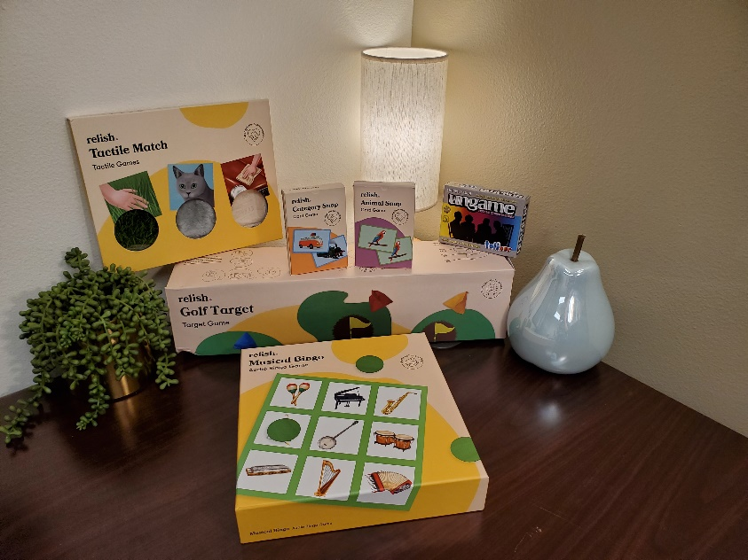
Dementia Resource Library

Slide 2
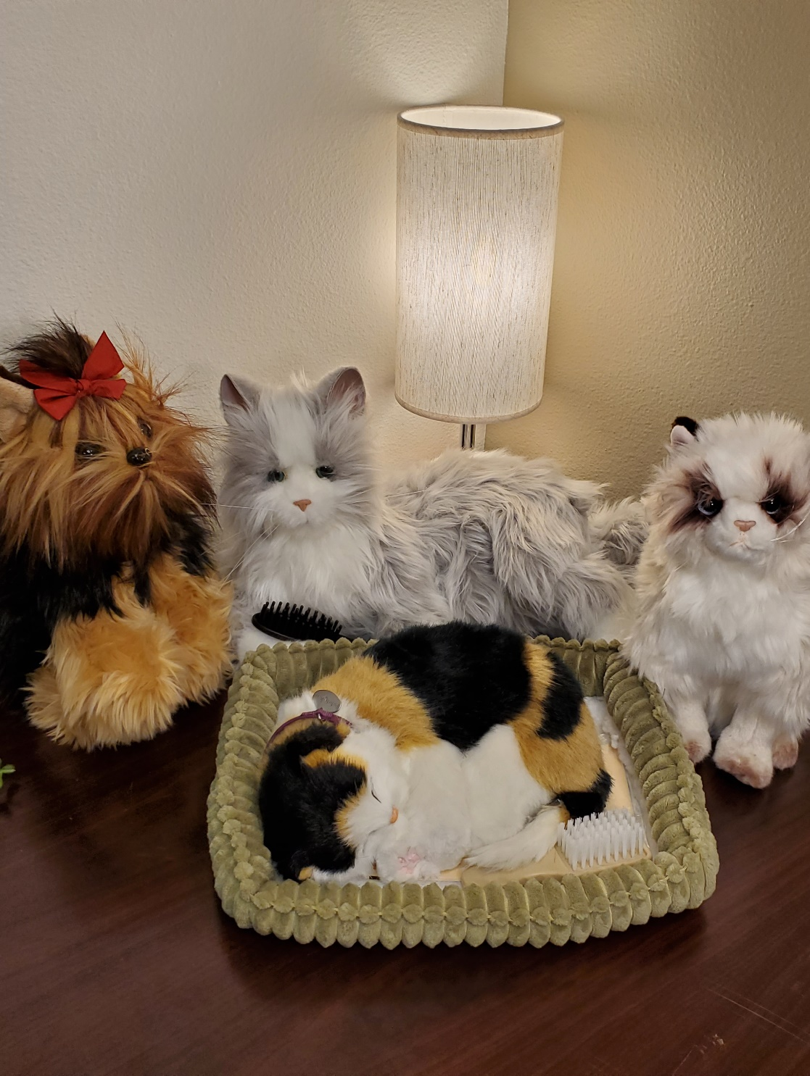
Comfort Items
Comfort items are objects that can provide some peach and calm to a person who might be experiencing emotions of distress or undesirable behaviors.

Slide 3
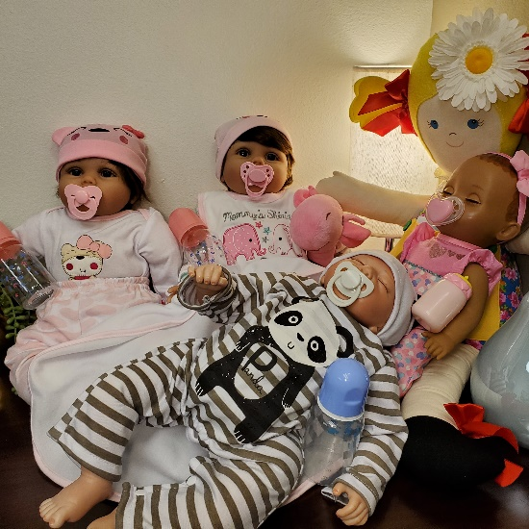
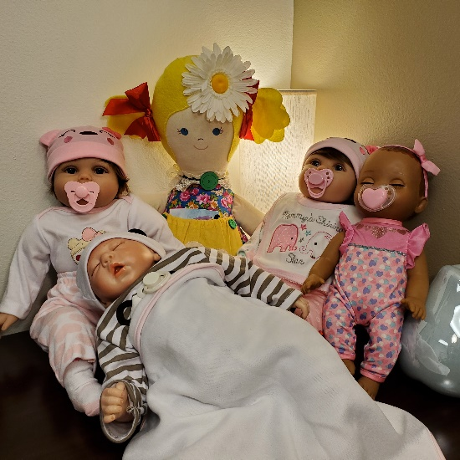
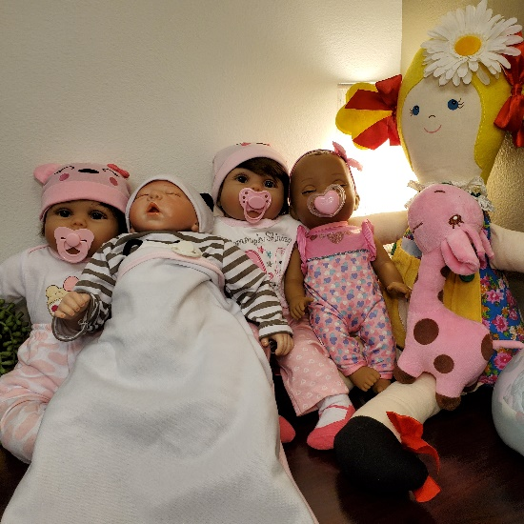
Baby Dolls
Baby dolls can be considered comfort items as well as reminiscence items for people who may be regressing back to when they were parents of a baby or when they were a child. Some dolls are weighted to feel more lifelike, while others make lifelike noises and actions. Similarly, some people may thrive with a stuffed doll with a picture book of memories in its front pocket.

Slide 4
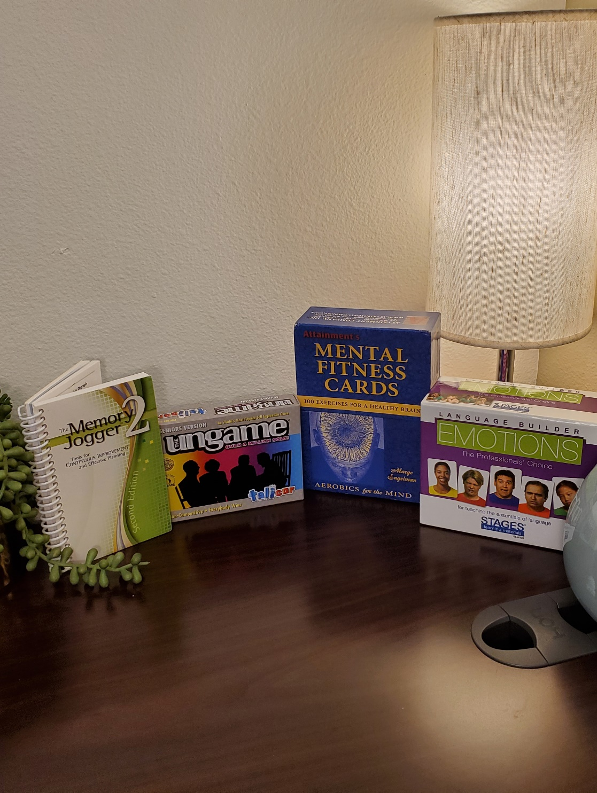
Mental Fitness Activities
Mental fitness activities are important at all stages of life. Brain strengthening activities such as puzzles and trivia challenges can help to reduce the risk of developing Alzheimer’s disease or other dementia for people who are not experiencing symptoms. For those who are experiencing symptoms or who have a diagnosis, mental fitness can help to slow memory loss.

Slide 5
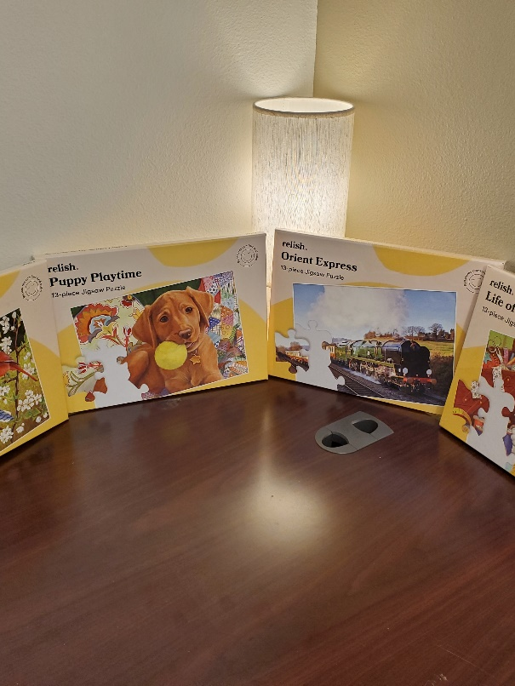
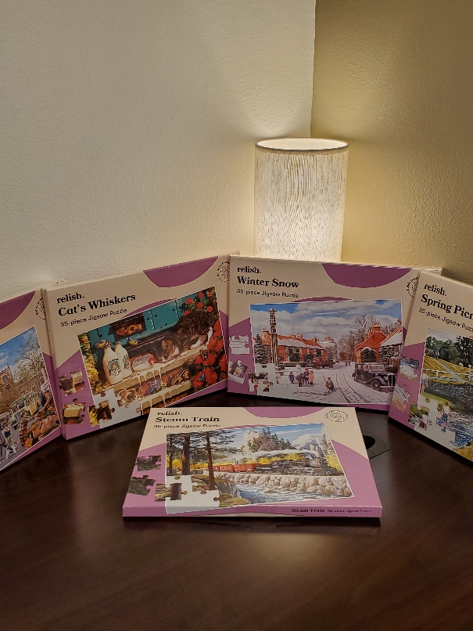
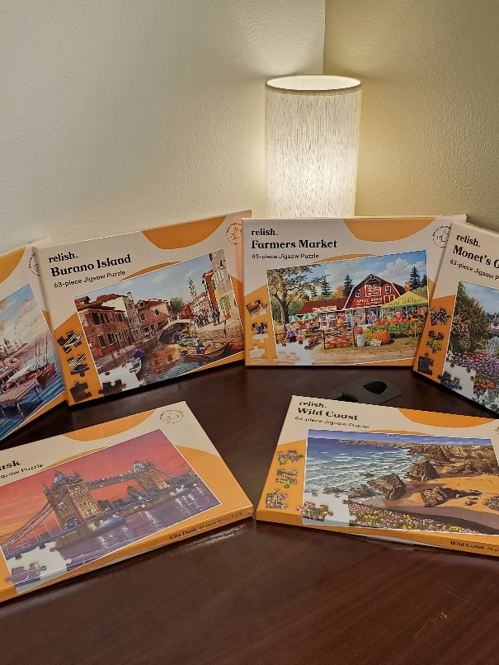
Puzzles
13-Piece Puzzles
35-Piece Puzzles
63-Piece Puzzles

Slide 6
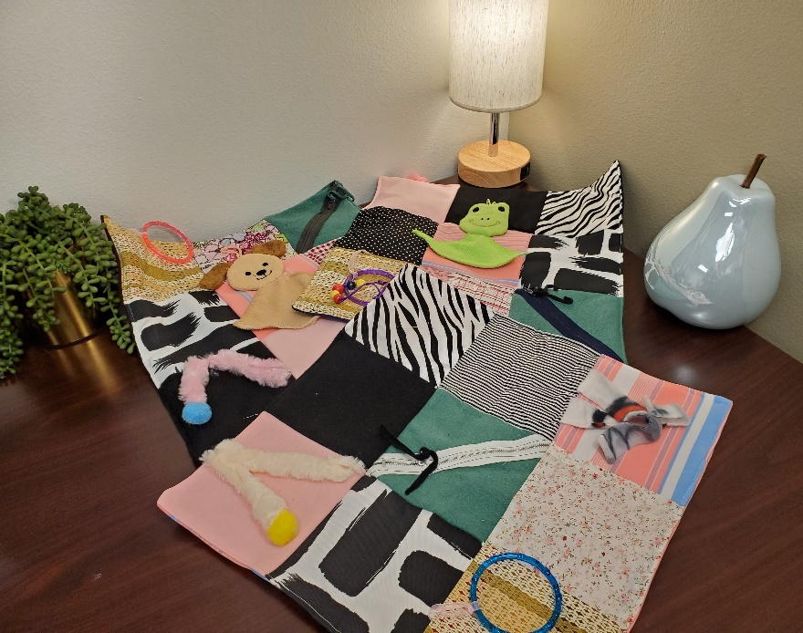
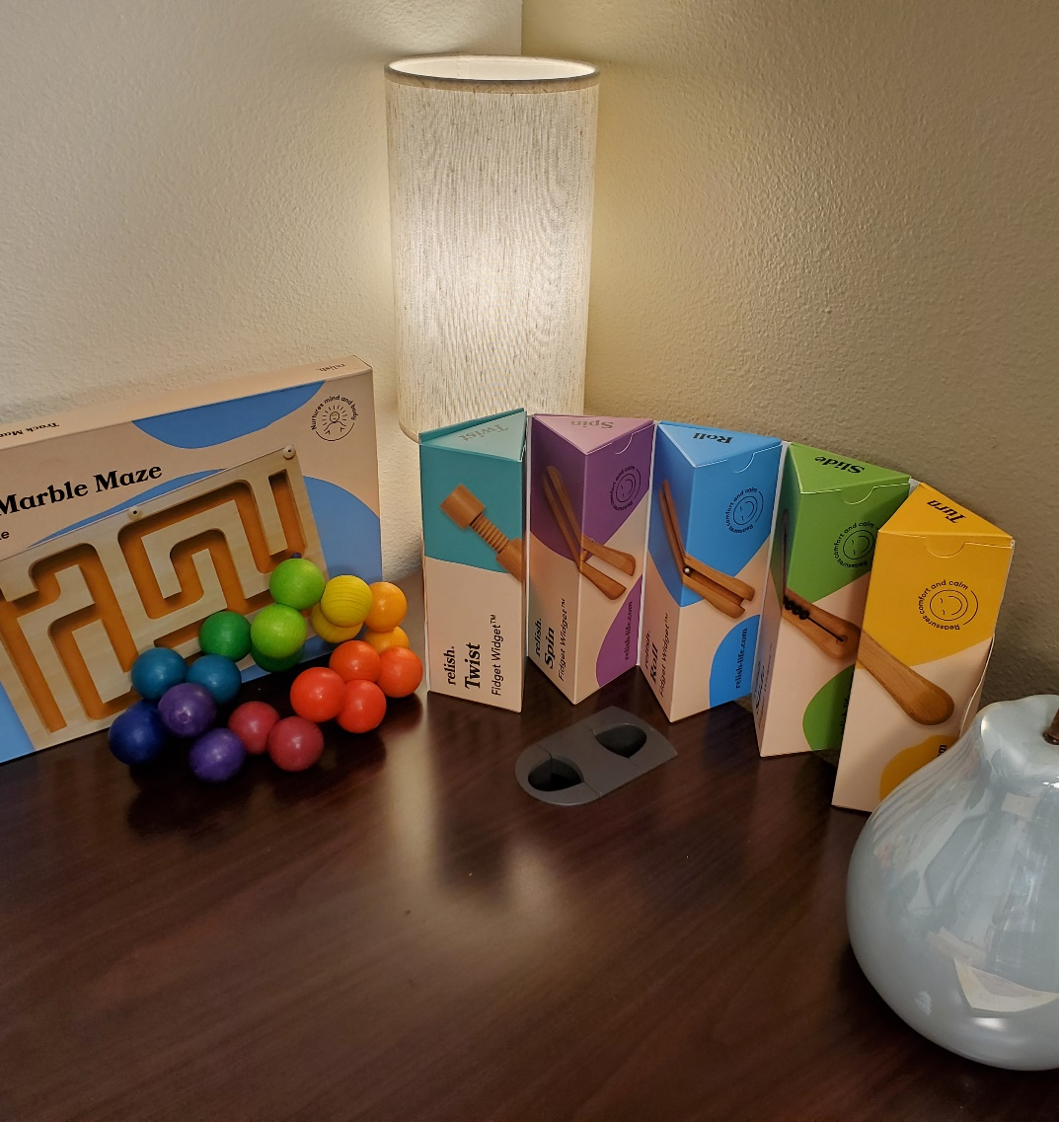
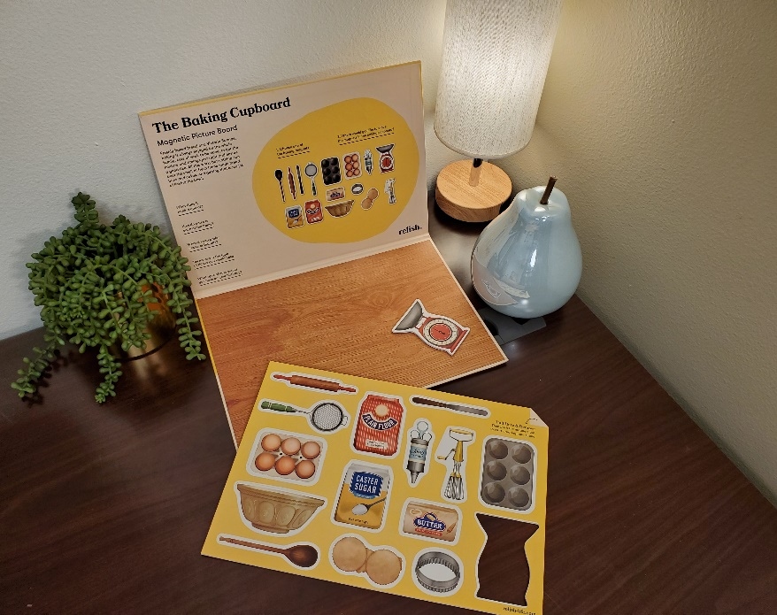
Fidget Resources
Fidgets can help a person who may be feeling anxious by giving their hands something to do.

Slide 7
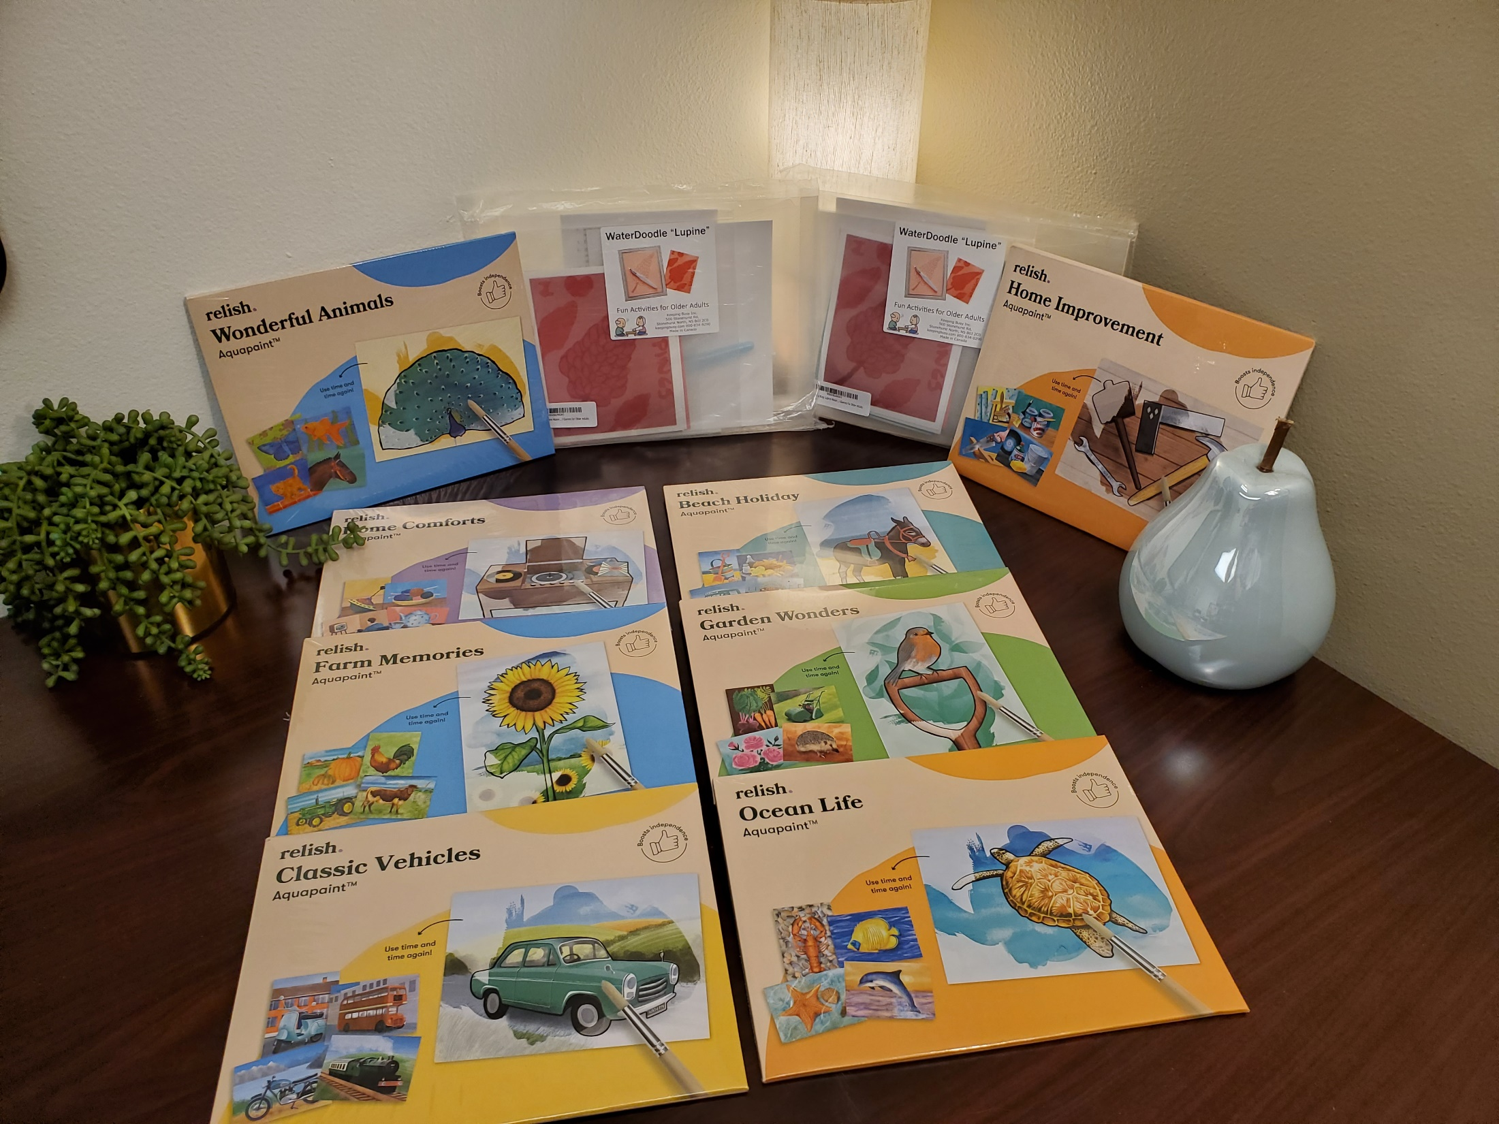
AQUAPAINT
Aquapaints are a great activity that require only a paintbrush and water. These masterpieces are reusable opportunities for people to remain creative day after day.

