Slide 1
3RD ANNUAL deck the county
Monroe County Christmas Tree
Decorating Contest

Slide 2
SPREADING CHEER THROUGHOUT
MONROE COUNTY

Slide 3
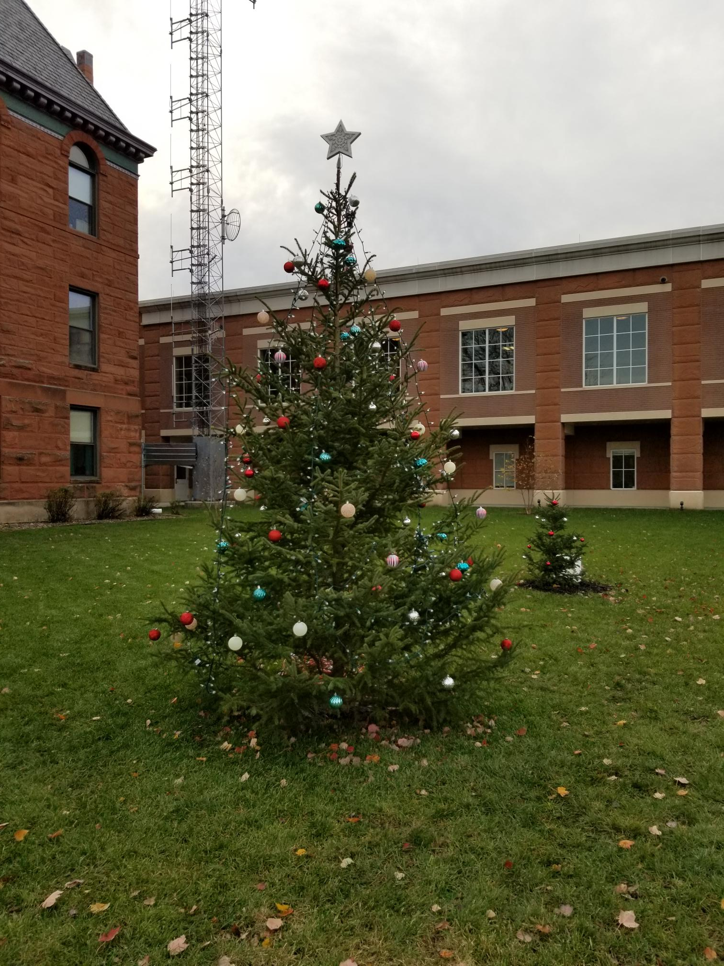
2ND ANNUAL
MONROE COUNTY CHRISTMAS TREE
DONATED BY
GERALD “JUG” KANN

Slide 4
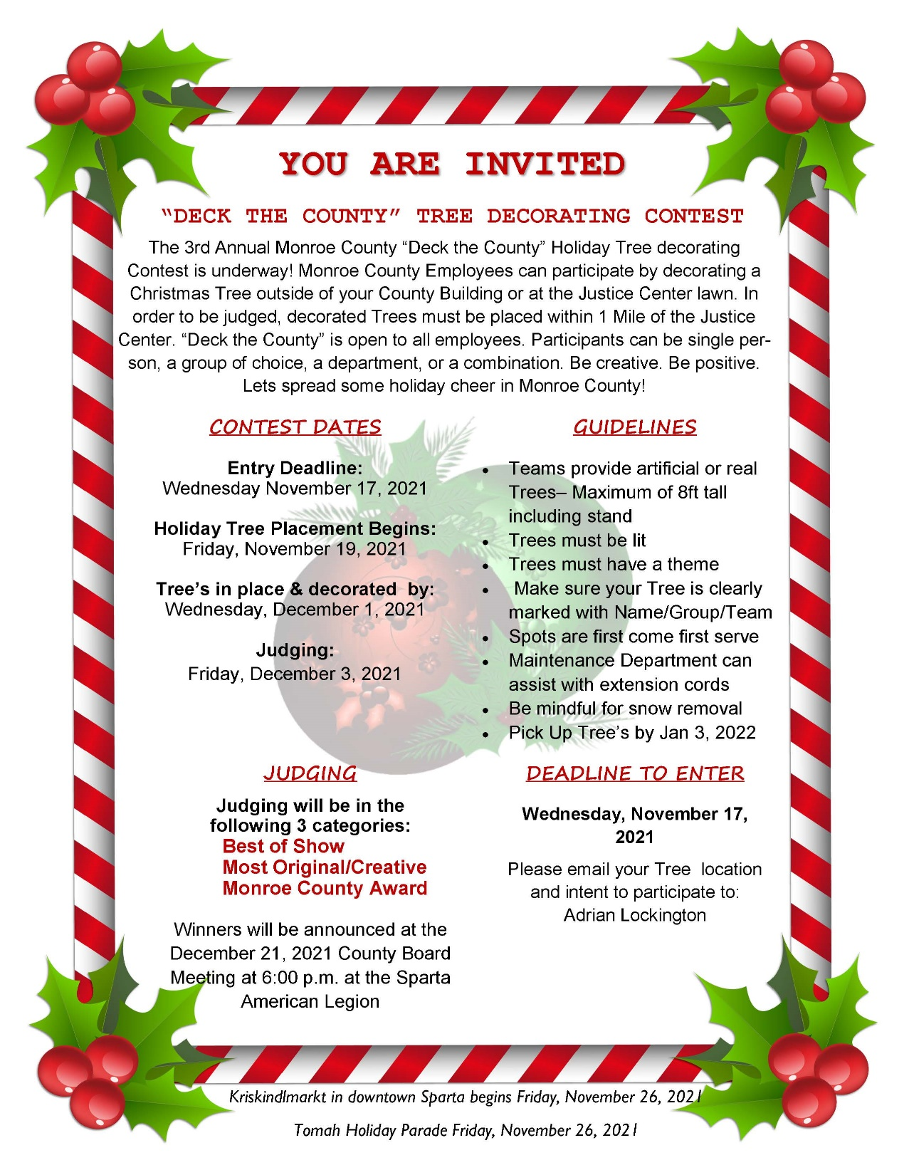
2021 CONTEST RULES & GUIDELINES

Slide 5
PARTICIPANTS & THEME
CLERK OF COURTS – USA
JUSTICE PROGRAMS/SHERIFF MERRY MISFITS - CHARLIE BROWN
UW EXTENSION - 101 DALMATIONS (MOVIE)
HUMAN SERVICES ESS UNIT - CANDY CANES
CIRCUIT COURT - LET IT SNOW
HUMAN SERVICES CFS UNIT- INSIDE OUT (MOVIE)
ROLLING HILLS - O’ CONSTRUCTION TREE
FINANCE - SANTA’S ELVES
TREASURER/REGISTER OF DEEDS/COUNTY CLERK/VETERAN SERVICES - GRANDMA GOT RAN OVER BY A REINDEER
HEALTH - SNOW FEAR WE’RE HERE
ADRC - THE GIVING TREE

Slide 6
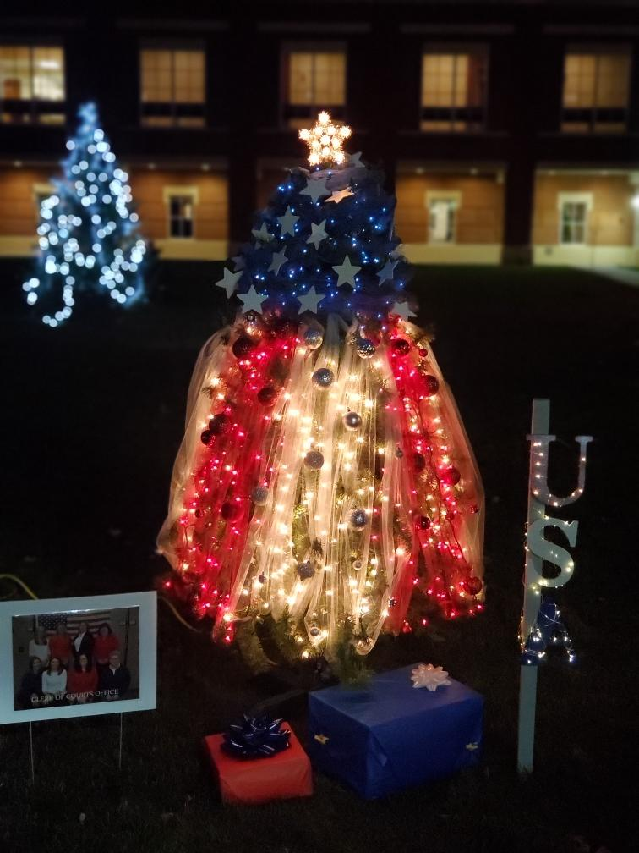
CLERK OF COURTS
USA

Slide 7
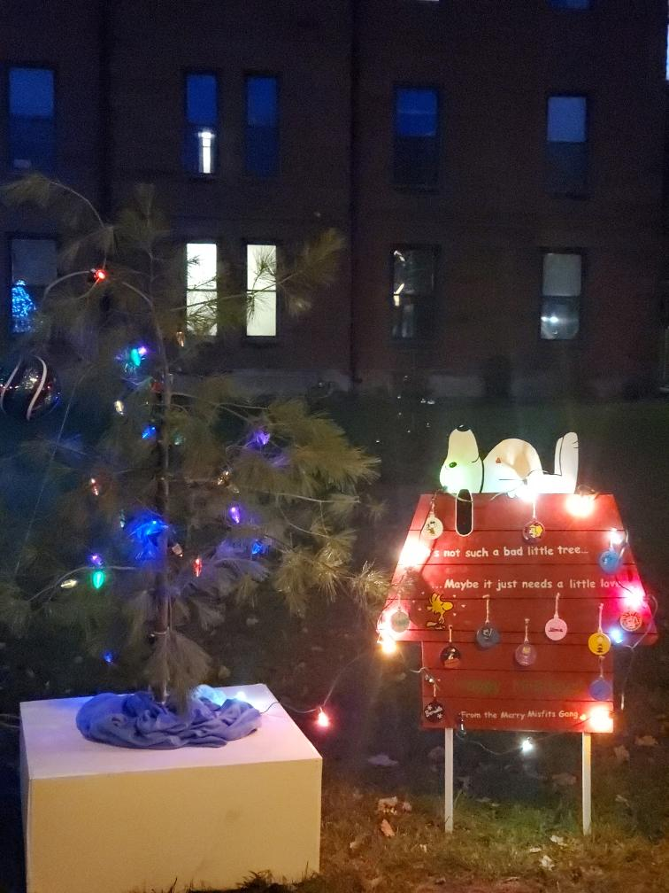
JUSTICE PROGRAMS/SHERIFF
MERRY MISFITS
CHARLIE BROWN

Slide 8
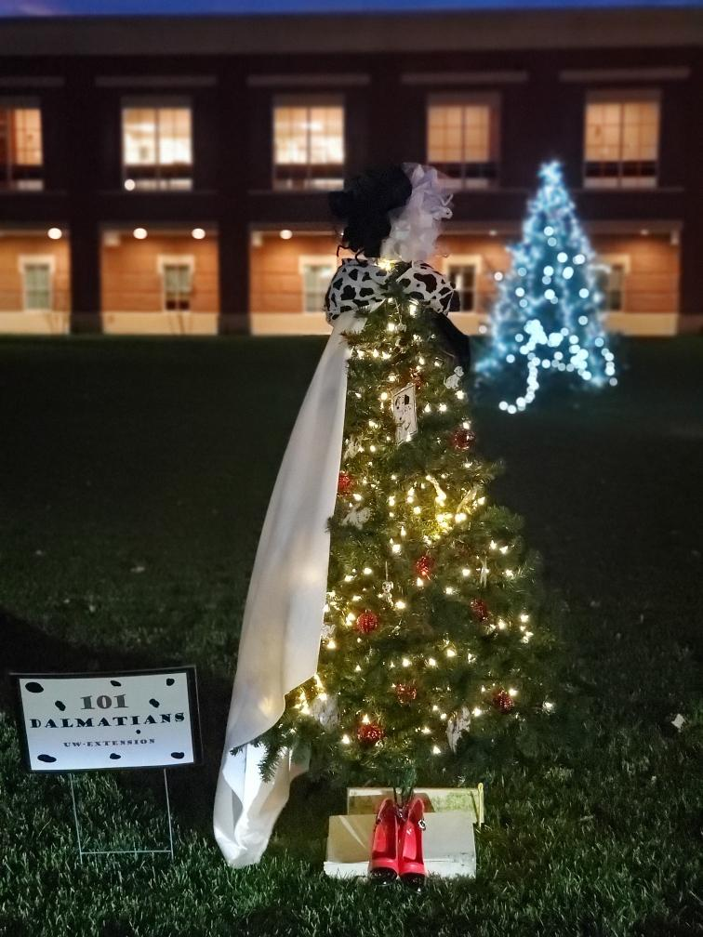
UW EXTENSION
101 DALMATIONS

Slide 9
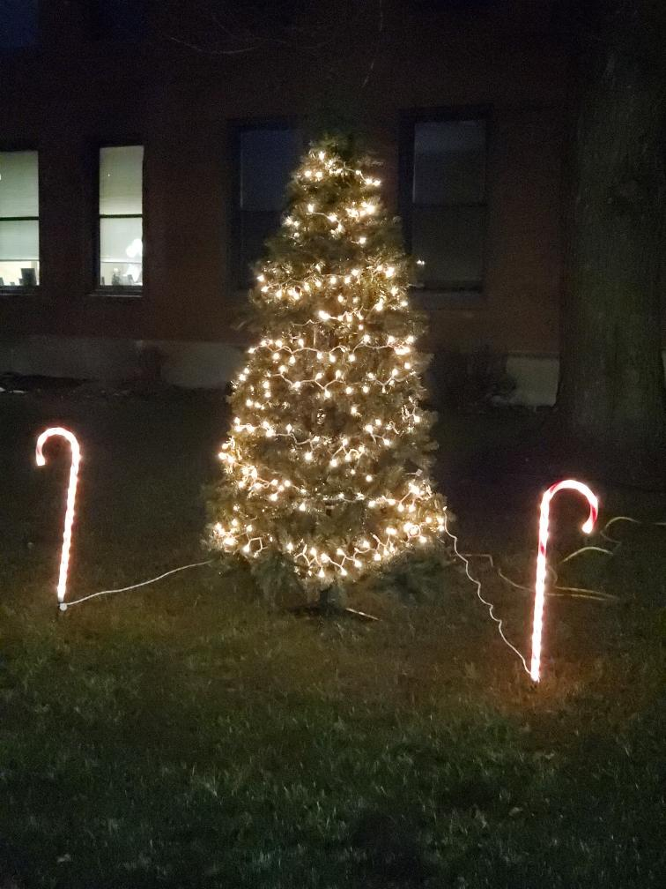
HUMAN SERVICES
ESS UNIT
CANDY CANES

Slide 10
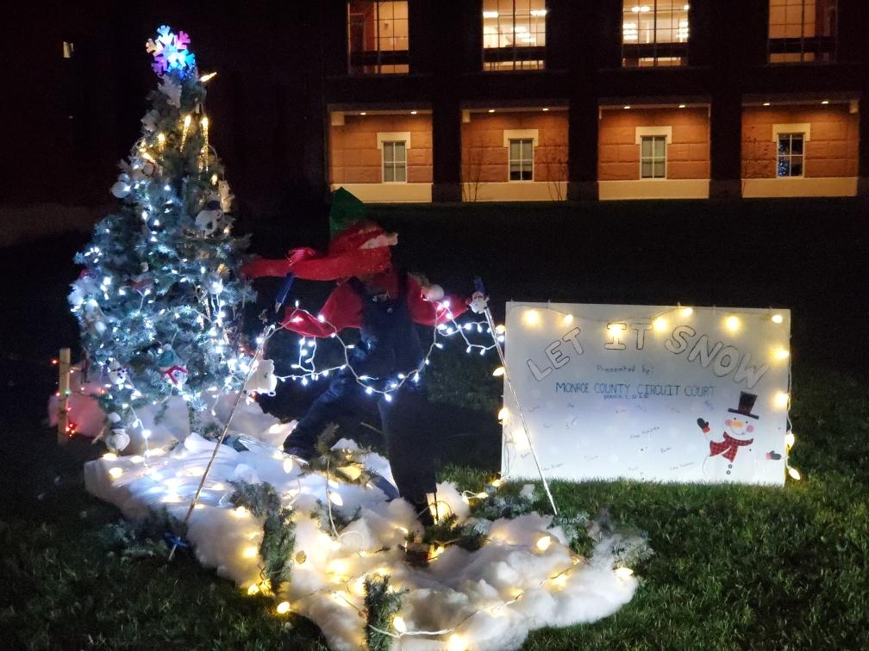
CIRCUIT COURT
LET IT SNOW

Slide 11
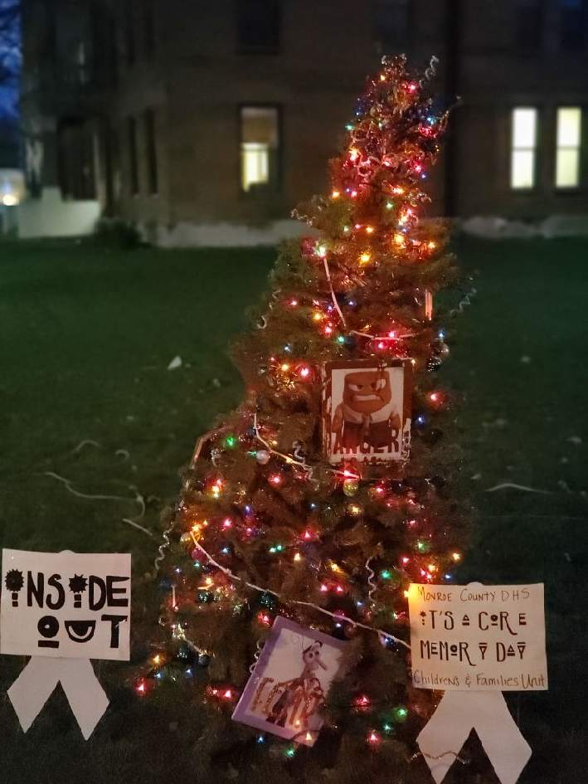
HUMAN SERVICES
CFS UNIT
INSIDE OUT

Slide 12
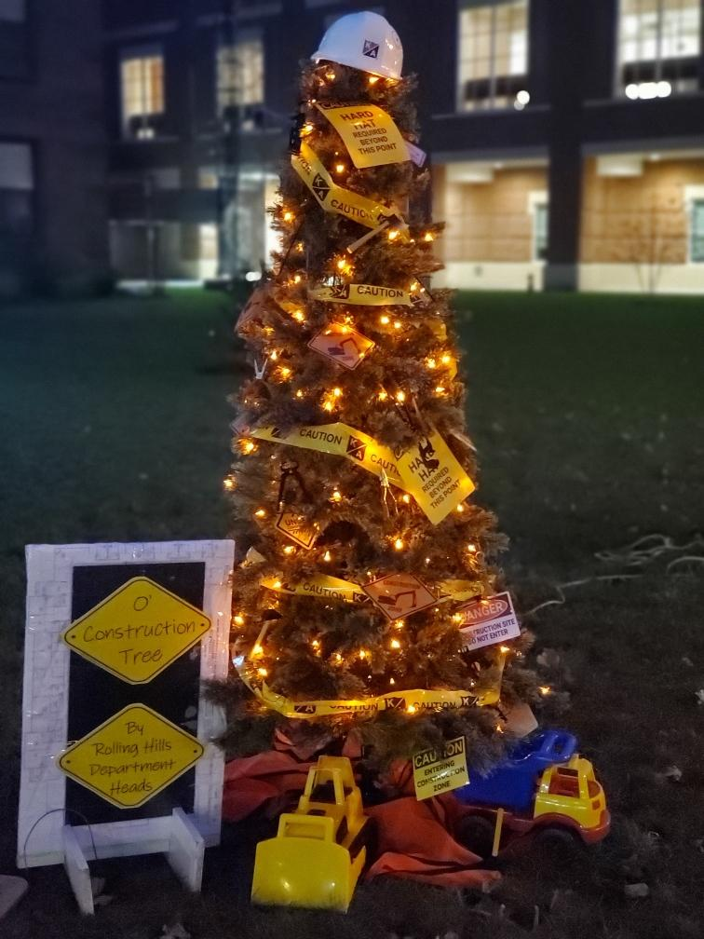
ROLLING HILLS
O’ CONSTRUCTION TREE

Slide 13
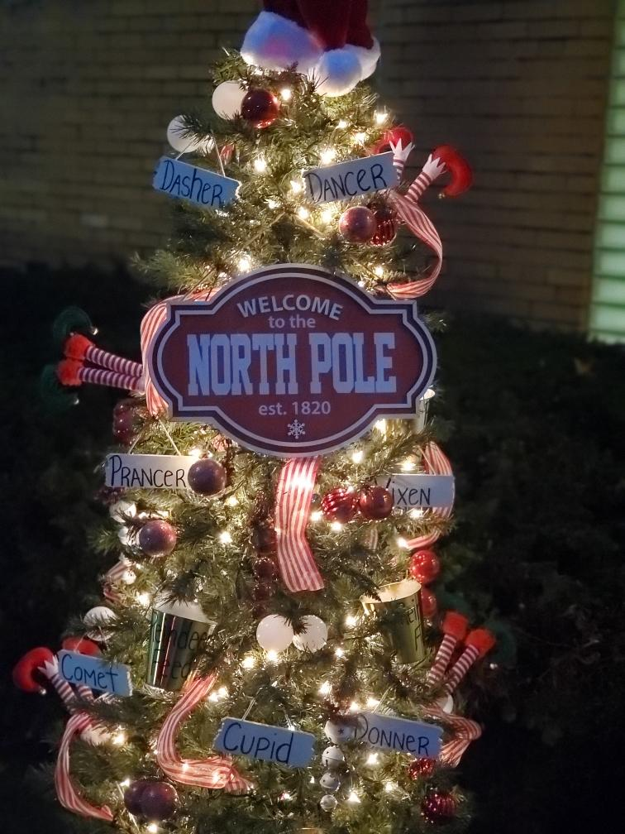
FINANCE
SANTA’S ELVES

Slide 14
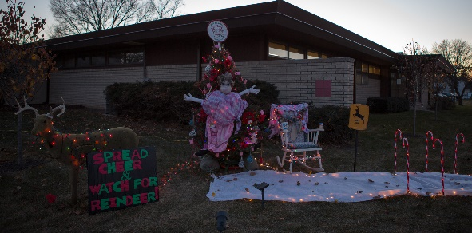
ADMINISTRATIVE CENTER
GRANDMA GOT RAN OVER BY A REINDEER

Slide 15
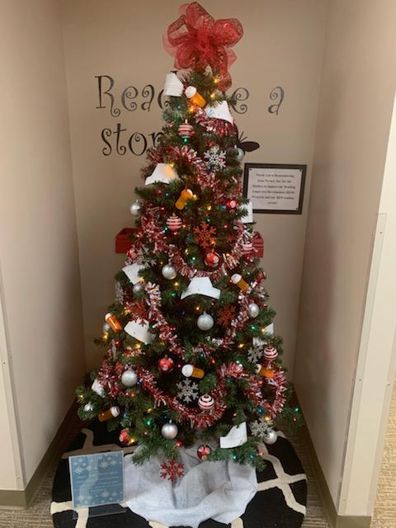
HEALTH
SNOW FEAR, WE’RE HERE

Slide 16
ADRC
THE GIVING TREE

Slide 17
A VERY SPECIAL THANK YOU TO THE 2021 OFFICIAL JUDGES
JIM KUHN – DAVID PIERCE – WALLY HABHEGGER – TONI WISSESTAD

Slide 18
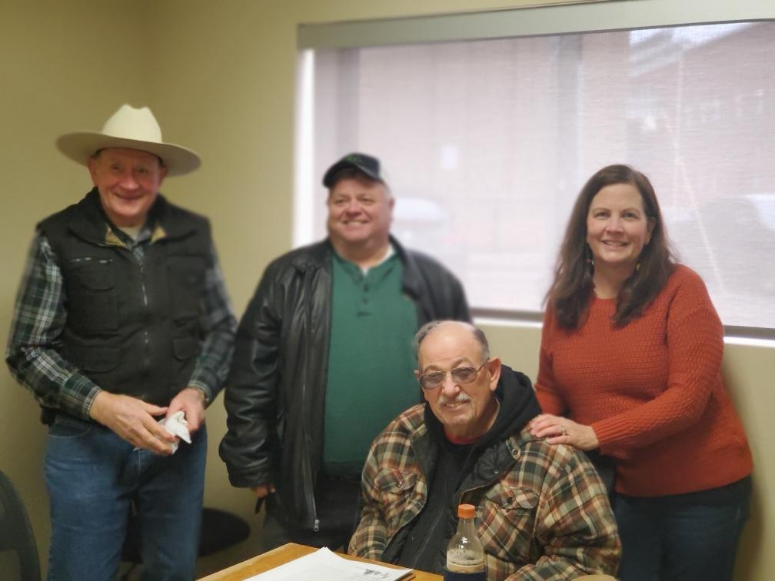

Slide 19
AND THE AWARDS GOES TO…………..

Slide 20
WINNER
BEST OF SHOW
CLERK OF COURTS
USA

Slide 21
WINNER
MOST ORIGINAL/CREATIVE
ADMINISTRATIVE CENTER
GRANDMA GOT RAN OVER BY A REINDEER

Slide 22
WINNER
MONROE COUNTY AWARD
ROLLING HILLS
O’ CONSTRUCTION TREE

Slide 23
WAIT!
THERE’S MORE!
NEW THIS YEAR….

Slide 24
2021 HONORABLE MENTION
FINANCE

Slide 25
A VERY SPECIAL TREE DECORATED AND DEDICATED TO THE COUNTY BOARD SUPERVISORS
BY THE COUNTY CLERK’S OFFICE

Slide 26
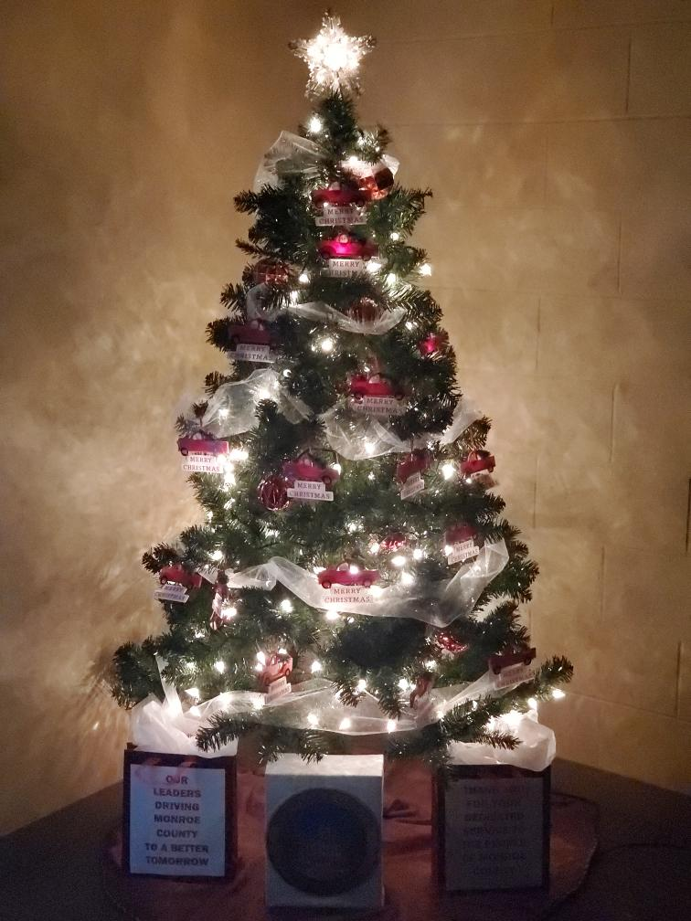
OUR LEADERS DRIVING
MONROE COUNTY
TO A BETTER TOMORROW

Slide 27
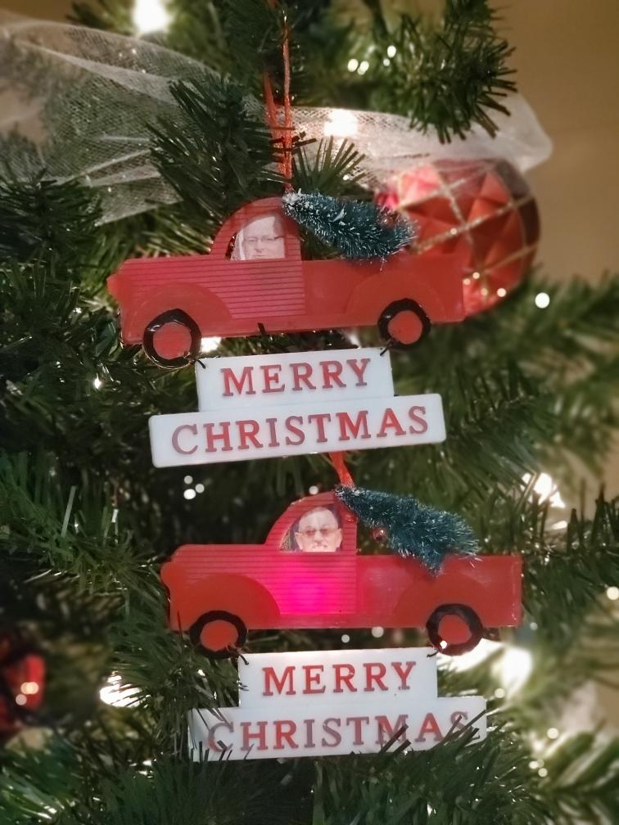
BEEP! BEEP! CEDRIC
BEEP! BEEP!
WALLY

Slide 28
A SPECIAL THANK YOU
TO
ALL THE STAFF THAT PARTICIPATED IN THE 3RD ANNUAL EVENT
CEDRIC SCHNITZLER
TINA OSTERBERG
MAINTENANCE DEPARTMENT

